Slide 1
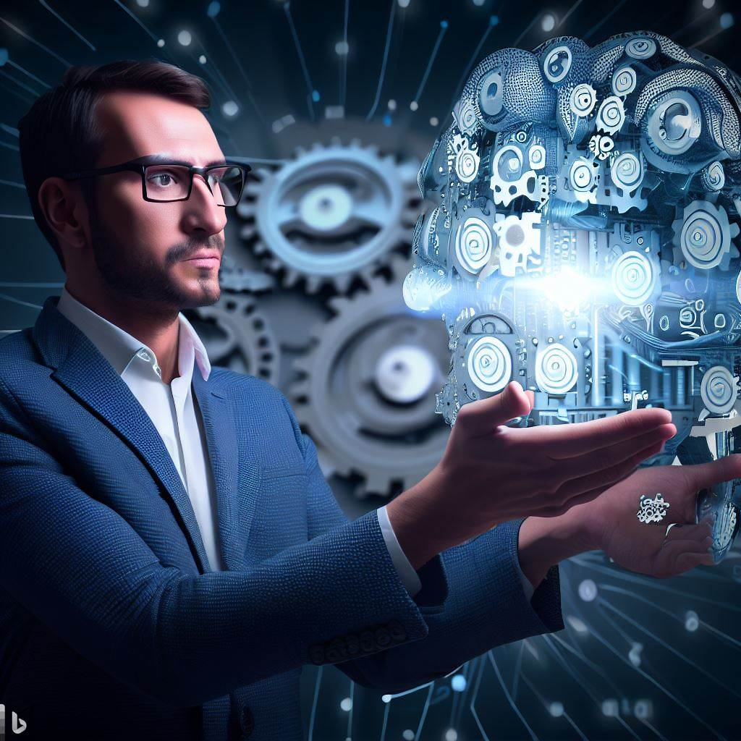
Machine Learning ----Overview----

Slide 2
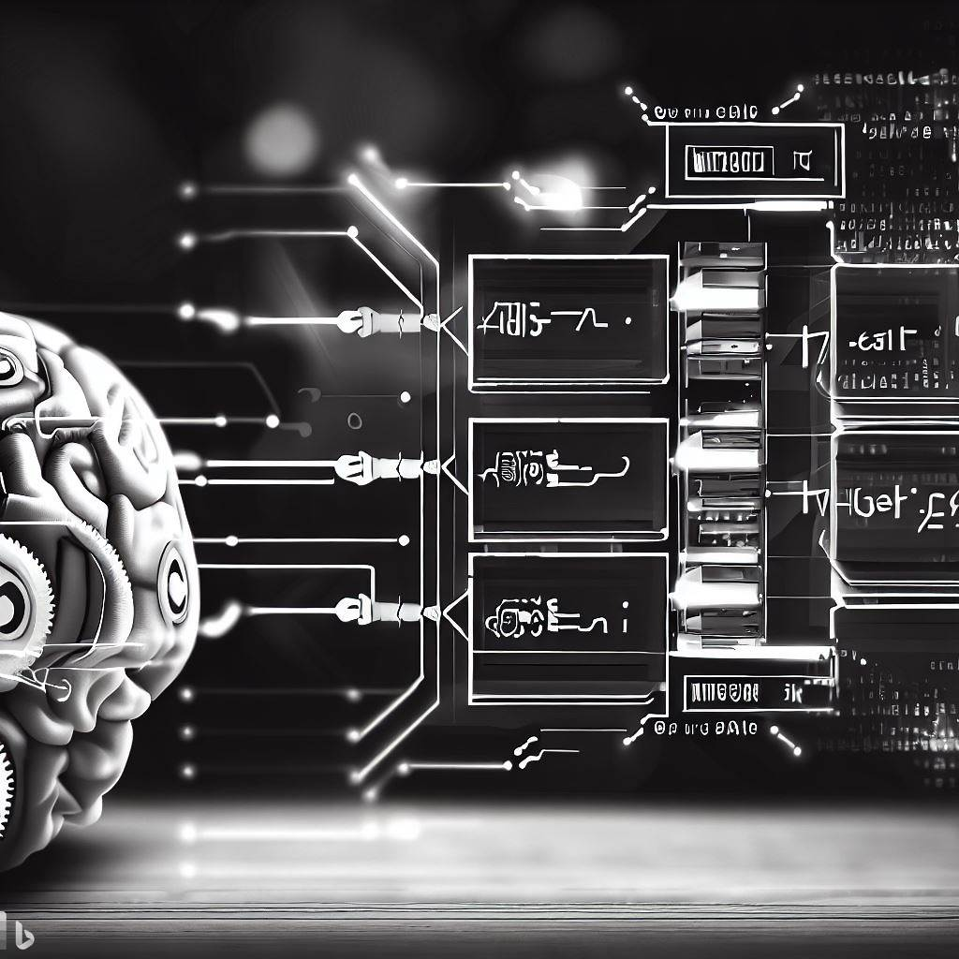
01 Machine Learning
What Is machine learning?
History of machine learning and key figures in machine learning
Machine learning at present
7 steps of machine learning
programming
How does machine learning work?
Machine learning algorithm
Machine learning use cases
How to choose machine learning algorithm
Why to use decision tree algorithm
Application of machine learning
Why it is important and the importance of human element
Some famous researches on Machine learning

Slide 3
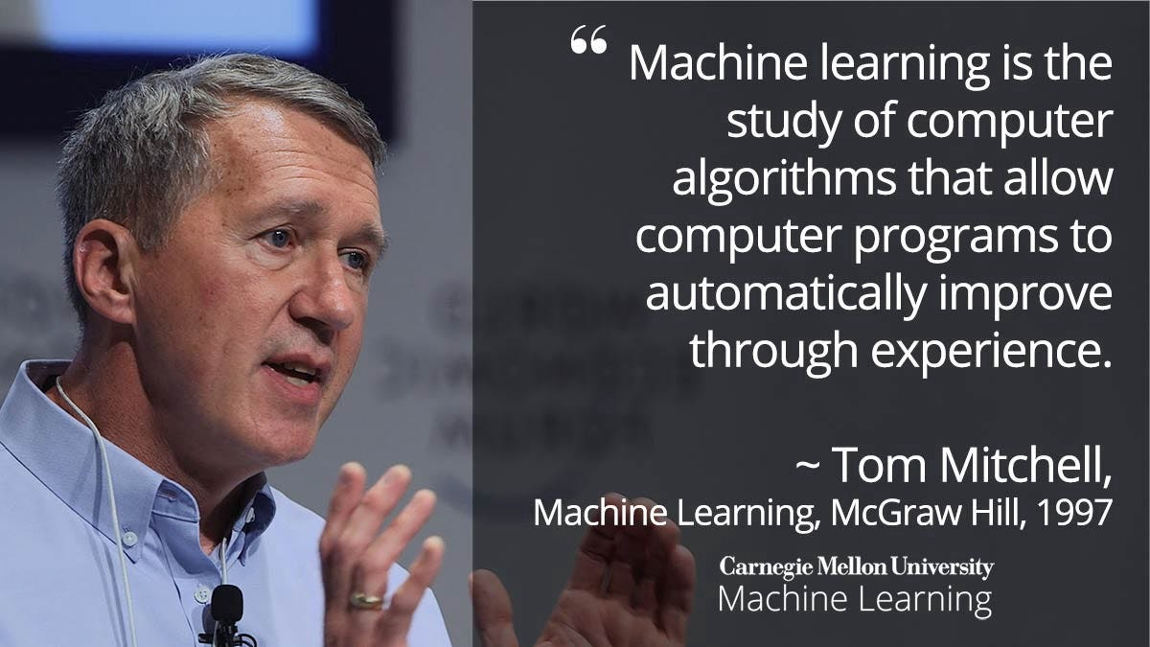

Slide 4

Example of machine learning :Showing us best recommendation based on our search result

Slide 5
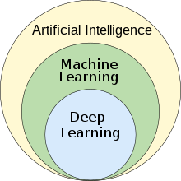
Machine Learning?
is a branch of Artificial Intelligence that leverages data to improve computer performance by giving machines the ability to learn.
**The science of getting computers to act without being explicitly programmed **

Slide 6
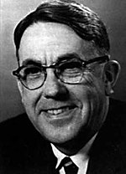
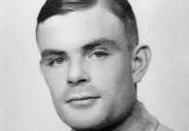
HISTORY OF MACHINE LEARNING
1950 : Alan Turing created a test to check if a machine could fool a human being into believing it was talking to a machine.
1952 : The first computer learning program, a game of checkers, was written by Arthur Samuel
1959: Term "machine learning" coined by Arthur Samuel
1957: Frank Rosenblatt developed the Perceptron, the first machine learning algorithm.
1967: Nearest neighbor algorithm conceived.
1970s-1980s: AI research shifted towards logical and knowledge-based approaches, distancing from neural network research. This separation gave rise to the distinction between Artificial Intelligence and Machine Learning..
1979 : Students of Stanford University. California, invented the Stanford Cart which could navigate and avoid obstacles on its own.
Arthur Samuel
Alan Turing

Slide 7

1990s: Introduction of Boosting algorithms; Also the availability of large set of datasets and powerful computers leads to resurgence of in machine learning research [2]
1997 :IBM's Deep Blue beats the world champion at Chess
2000s: Practical applications in spam filtering, fraud detection, and image recognition.
2016: AlphaGo algorithm developed by Google DeepMind wins all five games in the Chinese Board Game Go competition.
2020s: Machine learning gains prominence across industries.
1950 Alan Turing created a test to check if a machine could fool a human being into believing it was talking to a machine.
1952 The first computer learning program, a game of checkers, was written by Arthur Samuel
1957 First neural network for computers (the perceptron) was invented by Frank Rosenblatt, which simulated the thought processes of the human brain.
1967 The Nearest Neighbor Algorithm was written
1979 Students of Stanford University. California, invented the Stanford Cart which could navigate and avoid obstacles on its own.
1997 IBM's Deep Blue beats the world champion at Chess
2016 AlphaGo algorithm developed by Google DeepMind managed to win five games out of five in the Chinese Board Game Go competition.

Slide 8
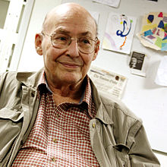
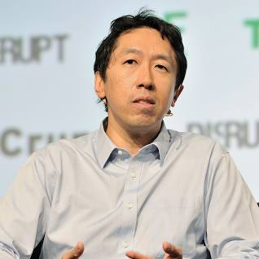
Some Key Figures In The History Of Machine Learning
1. Walter Pitti and Warren McCulloch : These two developed first mathematical model of neural networks.
2.Arthur Samuel an IBM researcher credited with coining the term machine learning
3.Frank Rosenblatt :developed perception
4. Marvin Minsky : this MIT professor is considered one of the founding fathers of AI.
Geoffery Hinton : considered as ore of the pioneer of deep learning.
5. Andrew Ng : is a leading expert in ML and AI
Marvin Minsky
Andrew Ng

Slide 9
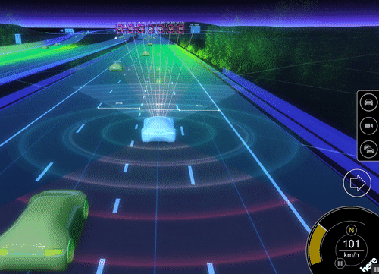
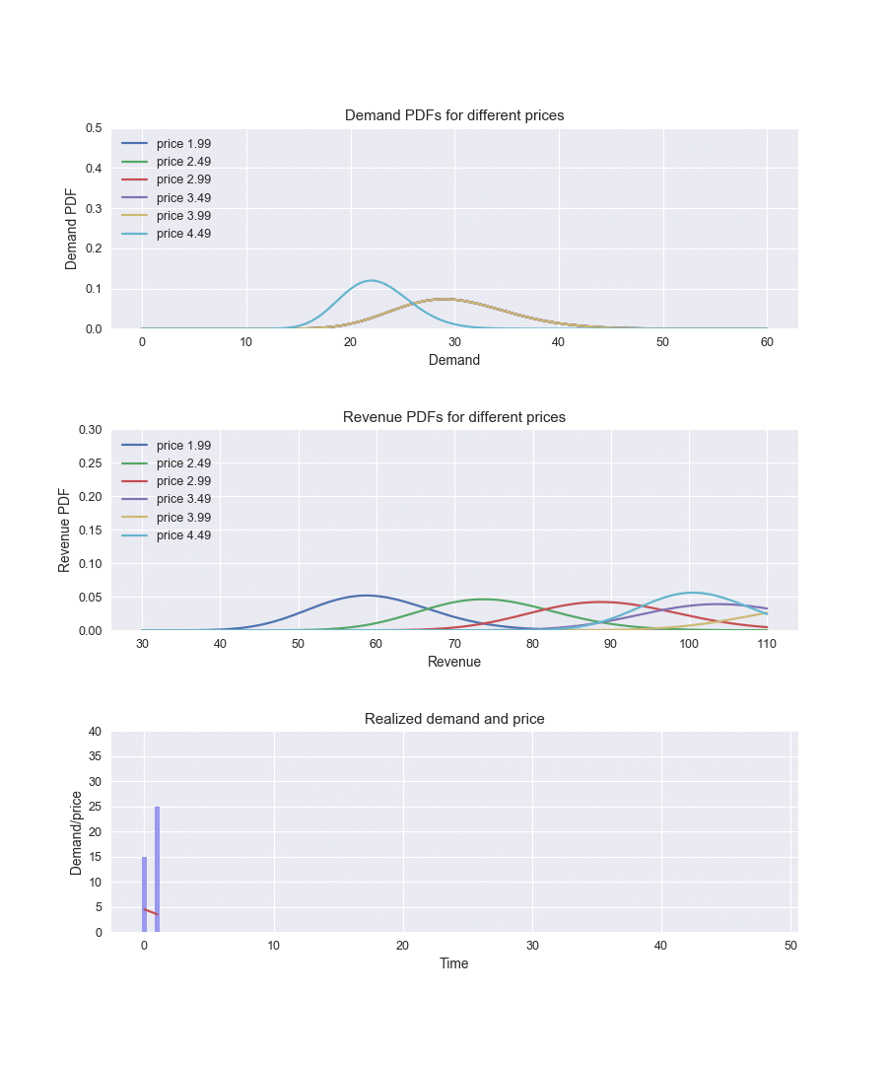
MACHINE LEARNING AT PRESENT
Machine learning is now responsible for some of the most significant advancement in technology like:
Self driving cars
For exploring Galaxy to explore exoplanets
Analysing Sales Data : Streaming the data
Real Time personalization : Promoting the Experience
Fraud Detection : Detecting pattern change
Product Recommendation : Customer personalisation
Dynamic Pricing : Flexible pricing based on need or demand
Natural Language Processing : Speaking with humans

Slide 10
7 steps of machine learning
07 Predictions
01 Gathering data
02 preparing that data
03 Choosing a model
04 Training
05 Evaluation
06 Hyperparameter Tuning

Slide 11

Why do we need Machine Learning
Suppose we have images of cats and dogs and now we want to classify them .To do so we need to find fallowing features :
How many eyes does each have
Colour of eye
Height of each animal
Their Weight
What they eat
We can form a vector of each of these ,next we will apply the rule as
if height→1 feet and weight →15lbs ,then it could be cat

Slide 12
What Machine Learning Does
Is process the data with different kinds of algorithm tells us feature is more important to determine whether it is a cat or dog .
Instead of applying many set of rules we can simplify it based on 2 or 3 features , it gives high accuracy

Slide 13
HOW DOES MACHINE LEARNING WORKS
Define Objective
Identify , the problem to be solved and create a clear objective
Collect Data
Collect data from any sources like
Hospitals , police , fire dept.
Prepare Data
Preparing data is a crucial step and involves building workflows to clean , match and blend the data
Select Algorithm
Train Models
Data is fed as input and the algorithm configured with the required parameters . A percent of the data can be utilized to train the model
Test model
The remaining data is utilized to test the model for accuracy.
Depend on the problem to be solved and the type of data an appropriate algorithm will be chosen
Depending on the result , improvements can be performed in the Train Model and/or Select Algorithm
Integrate Model
Publish the prepared experiment as a web service , so applications can use the model
[4]

Slide 14
MACHINE LEARNING ALGORITHMS
MACHINE LEARNING
UNSUPERVISED
REINFORCEMENT
SUPERVISED
REGRESSION
Clustring
Linear
Polynomial
Logistic
SVD Singular-Value Decomposition
PCA Principal Component Analysis
K-MEANS
DECISION TREE
CONTINUOUS
RANDOM FOREST
CLASSIFICATION
Association Analysis
KNN K-Nearest Neighbors Algorithm.
TREES
LOGISTIC REGRESSION
NALVE-BAYES
SVM support vector machine
APRIORI
FP-Growth Frequent Pattern
CATAGORICAL
Hidden Markov Model
[4]

Slide 15



SUPERVISED learning
It is an Apple!
🍎
🍎
🍎
🍎
💡
🍎
🍎
🍎
🍎
🍎
Machine Learning Algorithm
Processing
Train Model
New response
Known labeled data with Features
🍎
Unknown Data

Slide 16
Unsupervised learning
I can Sese A Pattern
🥭
🥭
🥭
🥭
🥭
🍎🍎🥭
🍎🥭
🥭
🥭
🥭
🍎
🥭🥭
🥭
🍎🥭
🍎🥭
💡
🥭
🍎
🍎
🍎
🍎
🥭
🍎
🍎
🍎
🍎
🍎
🍎
Machine Learning Algorithm
Trained Model
Processing
Response
Unknown data , not labeled with only features

Slide 17

REINFORCEMENT learning
Reinforced response
Wrong! It is apple
It is an mango!
Noted
It is an Apple!
🍎
🍎
🍎
🍎
🍎
🍎
🍎
🍎
Response
feedback
Learns
Input data
🍎
New input

Slide 18
REINFORCEMENT learning
ENVIRONMENT
REWARD
BEST ACTION
V
SELECTION OF ALGORITHM
STATE
INPUTTD RAW DATA
OUTPUT
AGENT

Slide 19
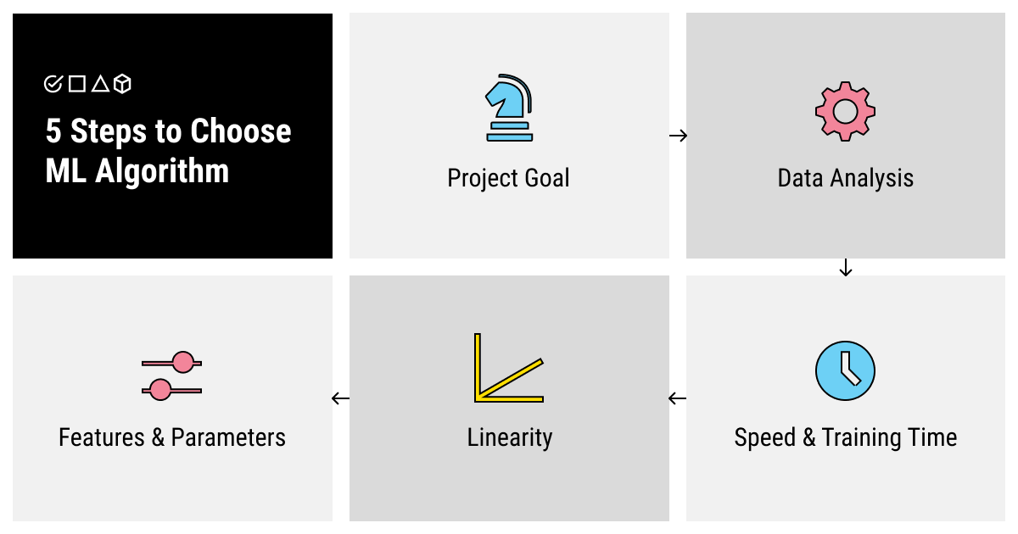
How to chose Machine Learning Algorithm
Understand your project Goal
Analyse your data by size , Process , and Annotation Required
Evaluate the speed and training time
Find out the Linearity of your data
Decide on the Number of Features and Parameters
[5]

Slide 20
Why to use decision tree algorithm
Decision trees are used to solve classification problems and categorize objects depending on their learning features.
Decision tree
To Classify
To Predict
Responsible variable is Continuous
Responsible Variable has only 2 Categories
Response Variable has Multiple Categories
Use Standard Classification here
Use c4.5 Implementation
Linear Relationship between Predictors & Response
Non-linear Relationship between Predictors & Response
They can also be used for regression problems or as a method to predict continuous outcomes from unforeseen data.
Use Standard Regression Tree
Use c4,5 Implementation

Slide 21






Machine Learning Use Cases
Manufacturing
1 Predictive Maintenance or Condition Monitoring
2 Demand Forecasting
Process Optimization
Telematics
Retail
1 Predictive Inventory Planning
2 Recommendation Engines
3 Customer ROI & Lifetime Value
Healthcare & Life Sciences
1 Alerts & Diagnostics from Real-time Patient Data
2 Predictive Health Management
3 Healthcare Provider Sentiment Analysis
Energy Feedstock & Utilities
1 Power Usage Analytics
2 Seismic Data Processing
3 Smart Grid Management
4 Energy Demand & Supply Optimization
Financial Services
1 Risk Analytics & Regulation
2 Customer Segmentation
3 Credit worthiness Evaluation
Travel & Hospitality
1 Aircraft Scheduling
2 Dynamic Pricing
3 Traffic Patterns & Congestion Management

Slide 22
Challenges and Limitations of Machine learning
Disadvantages
Advantages
Easily Identifies Trends and Patterns
Data Acquisition
No Human Intervention needed
High error- Susceptibility
Continuous Improvement
Applications Interpretation
Handling multi-dimensional & multi- variety Data
Time and Resources
Wide Applications
Computational resources and time constraints

Slide 23
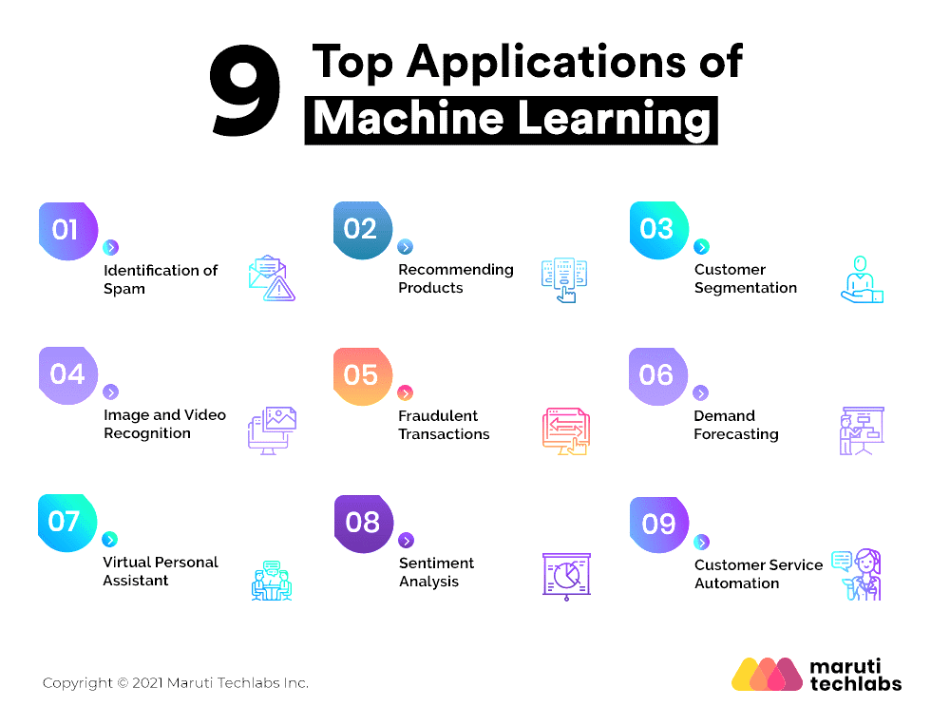
Application of machine learning

Slide 24
Why Machine learning is important.
Automation & Efficiency: Automates tasks, boosting efficiency.
Data-Driven Insights: Uncovers patterns for informed decisions.
Predictive Power: Accurately predicts trends and optimizes processes.
Personalization & Recommendation: Enhances user experiences
Continuous Learning: Improves performance over time.
Improved Decision Making: Provides valuable insights for better choices.

Slide 25
Why Machine learning is important.
Technological Advancements: Drives innovation in multiple fields
Healthcare & Medicine: Assists in diagnosis and personalized treatments.
Fraud Detection & Security: Identifies anomalies and enhances protection.
Enhanced User Experience: Powers virtual assistants and chatbots

Slide 26
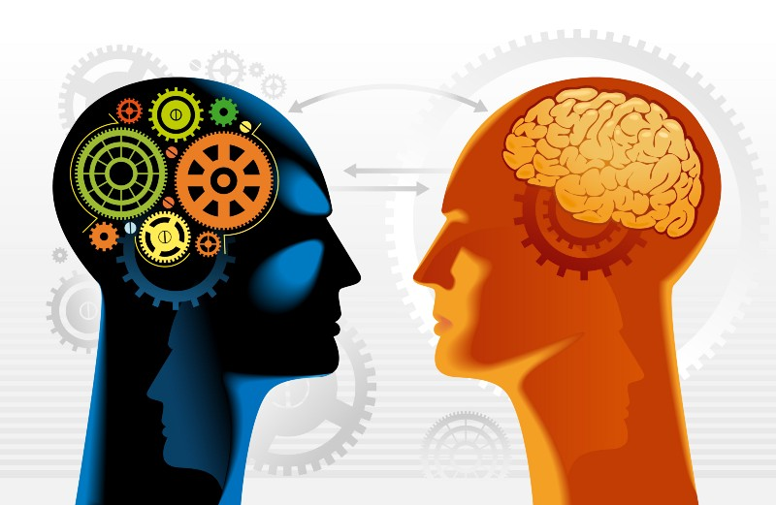
THE IMPORTANCE OF THE HUMAN ELEMENT
Technology, while intelligent, is not perfect.
Humans can accelerate the understanding process through real-time teaching.
Machine learning benefits from human intervention to comprehend complex data
When technology encounters incomprehensible data, humans can intervene.
Humans provide explanations, classifications, and context to enhance accuracy.
Machine learning algorithms incorporate this knowledge for future encounters.
The human touch enables machine learning to develop self-awareness.
By learning from human interactions, technology becomes more aware of its limitations and strengths.

Slide 27
Famous Research Papers On Machine Learning
1 : Backpropagation (1986)
by Geoffrey Hinton, David Rumelhart, and Ronald Williams
This paper introduced the backpropagation algorithm, which is a key technique for training deep neural networks.
2 :ImageNet Classification with Deep Convolutional Neural Networks (2012)
by Alex Krizhevsky, Ilya Sutskever, and Geoffrey Hinton.
This paper showed that deep convolutional neural networks could achieve state-of-the-art results on the ImageNet image classification challenge.
3 :Recurrent Neural Networks for Language Modeling (1997)
by Yoshua Bengio, Patrice Simard, and Geoff Hinton.
This paper introduced recurrent neural networks for language modeling, which are now widely used in natural language processing tasks such as machine translation and text summarization
4 : Deep Reinforcement Learning (2013)
This paper introduced generative adversarial networks (GANs), which are a type of deep learning model that can be used to generate realistic images, text, and other data.
by Mnih et al.
This paper introduced the deep Q-network (DQN), which is a deep reinforcement learning algorithm that has achieved state-of-the-art results on a variety of tasks, such as playing Atari games.
5 :Generative Adversarial Networks (2014)
by Ian Goodfellow et al

Slide 28
References
[1] : Wikipedia : https://en.wikipedia.org/wiki/Machine_learning
[2] : https://www.dataversity.net/a-brief-history-of-machine-learning
[3] : [images] : All images except Human Images are AI generated
[4] : https://www.slideteam.net/machine-learning-ml-overview-algorithms-use-cases-and-applications.html
[5] : https://labelyourdata.com/articles/how-to-choose-a-machine-learning-algorithm
[6]

Slide 29
THANKS

